Slide 1

India is Rich in Ideas but Poor in Financial Access & Literacy
In India, thousands of brilliant young minds give up on their entrepreneurial dreams—not because of bad ideas, but because they don’t understand money. Meanwhile, millions of people continue to struggle with daily financial problems due to lack of guidance, financial education, or trustworthy mentors
76% of Indian Adults lack basic financial literacy
70% of start-ups fail due to poor money management.
Lack of accessible mentorship & peer support
Disconnected efforts—no unified, trustworthy platform
This Photo by Unknown Author is licensed under CC BY-SA-NC

Slide 2
Your Digital Wealth Ally + Entrepreneurial Rotary Club
FinBuddy AI is a platform that brings together AI-powered financial learning, personalized growth plans, and a trust-based community of mentors and learners. It’s like having a financial expert, an entrepreneurial mentor, and a supportive tribe — in your pocket.
Key Features:
🤖 AI-Personalized Financial & Startup Growth Paths
🧩 Real-Time Mentorship Matching
📚 Gamified Learning Modules
🏆 Community Circles for Shared Learning
🔓 Unlock Access to Microfinance & Financial Tools

Slide 3
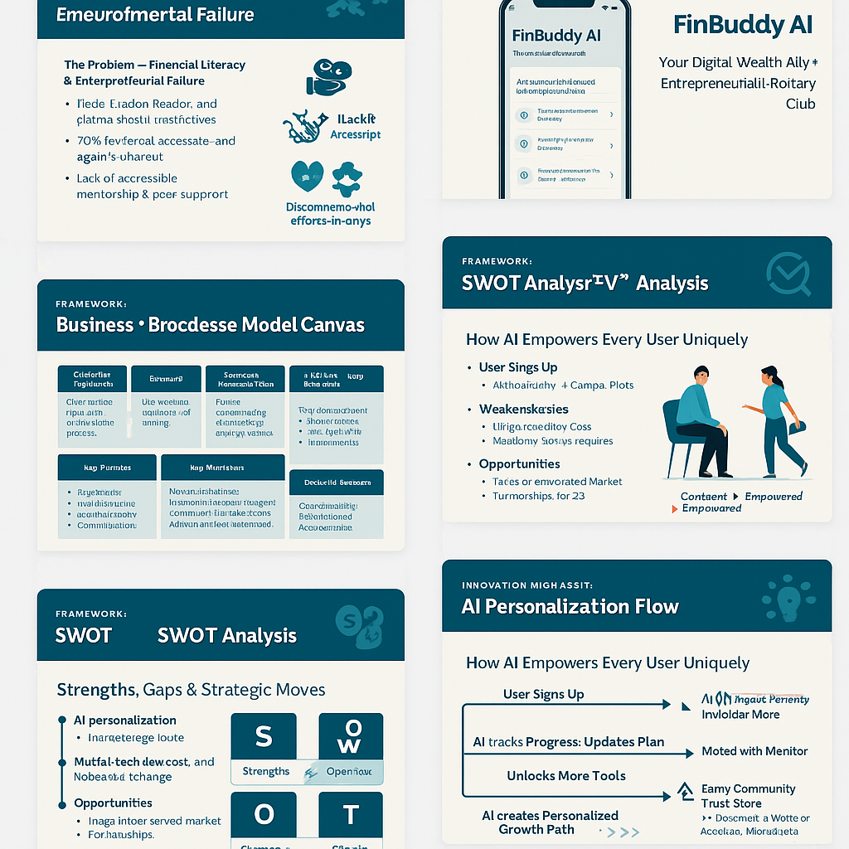
A Scalable, Community-Driven, AI-Enabled Platform
Customer Segments:
Young entrepreneurs (18–30), students, rural households
Value Proposition:
Personalized financial learning, peer mentorship, access to tools
Channels:
Mobile app, WhatsApp integration, voice-based AI
Customer Relationships:
AI personalization, community circles, gamification
Revenue Streams:
Freemium model, B2B institutional tie-ups, CSR-backed mentorship
Key Activities:
AI model training, content design, community moderation
Key Partners:
NGOs, colleges, fintech partners, microfinance companies
Cost Structure:
Tech development, mentor ops, community management

Slide 4

The Urgent Need! The Massive Opportunity
🧠 440M youth in India = untapped potential
💰 Fintech industry is booming ($150B market by 2027)
🌾 190M rural users with smartphones, need localized tools
🌍 Impact Projection: 1M+ lives empowered in 3 years
From Confused & Broke → To Confident & Empowered
This Photo by Unknown Author is licensed under CC BY-SA-NC

Slide 5
Strengths, Gaps & Strategic Moves
Strengths: AI personalization, community model, scalable
Weaknesses: Initial tech dev cost, behavior change required
Opportunities: Large underserved market, partnerships with colleges/NGOs
Threats: Competitor apps (limited community integration), trust issues in fintech

Slide 6
How AI Empowers Every User Uniquely
User Signs Up
↓
AI Financial Quiz → Income, Goals, Pain Points
↓
AI creates Personalized Growth Path:
- Learning modules (Budgeting → Tax → Funding)
- Toolkits & Simulations
- Matched with Mentor
↓
Tracks Progress → Updates Plan → Unlocks More Tools
↓
Earns Community Trust Score → Becomes a Mentor or Accesses Microfinance

Slide 7
A World Where Everyone Understands Money and Feels Empowered
We believe in a world where money is not a barrier, but a tool. A world where a young entrepreneur from a Tier 3 town has the same financial wisdom as someone from an IIM. A world where a mother in a rural village feels confident saving for her daughter’s future.
Execution (Visual Timeline):
Year 1: MVP Launch + 3 Campus Pilots
Year 2: Community Expansion + NGO + CSR Partnerships
Year 3: Rural Rollout + Voice AI + 1M Active Users
We are not just building a platform. We’re building a movement that brings financial power to the people

